Slide 1
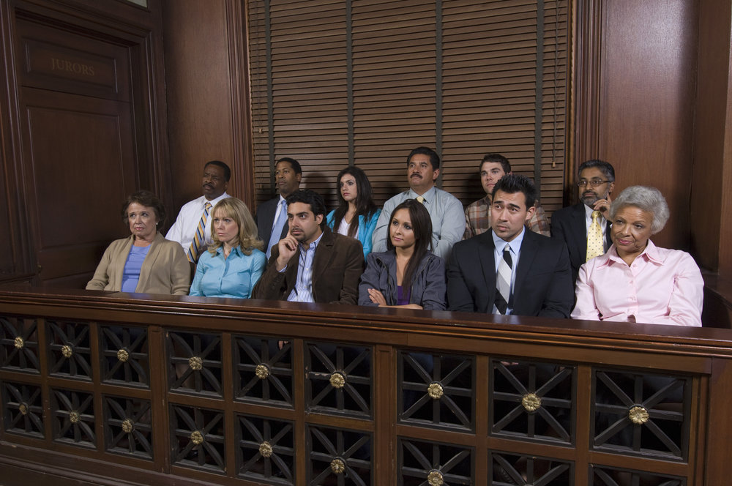
Diversity in Juries

Slide 2
Session Objectives
List
requirements for jury service.
Define
a diverse jury.
Identify
benefits from having diverse juries.
Identify
obstacles to diverse juries.
List
criteria used by Jury Administrators in selecting potential jurors for the jury pool.
Be
motivated to serve on juries when summoned.

Slide 3
Right to a JURY Trial
Who can tell me where the right to a jury trial comes from?
U.S. Constitution
6th Amendment – Criminal Defendants - Right to Impartial Jury
7th Amendment – Civil Trials – Cases at common law value over $20
Washington Constitution
Article 1, Section 21 Right to a Trial

Slide 4
Jury Duty

Slide 5
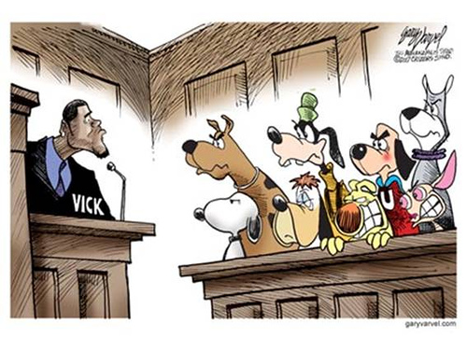
Quick writing task
If a loved one or family member were involved in a criminal case, who would they want to be on their jury? What would be a fair jury? Can a non-diverse jury be fair?

Slide 6
Justice Mary Yu Washington State Supreme Court
A diverse jury fully reflects our beautiful community in Washington by including individuals of various ages, genders, races, cultures, sexual orientations or identities, and abilities, and by representing our differing viewpoints, our varied personal experiences, our array of family structures, and our wide range of income, employment, and education.

Slide 7
Benefits of having a diverse jury?
Fundamental right.
Improves how people perceive or see justice.
Fairer trials when they are racially diverse.
Various life perspectives
Longer deliberations, more evidence, fewer errors and more readily fix errors, and more race-related discussions
Positive attitude towards jury service
More than 90 percent would serve again
Jurors more likely to vote by 10 percent

Slide 8
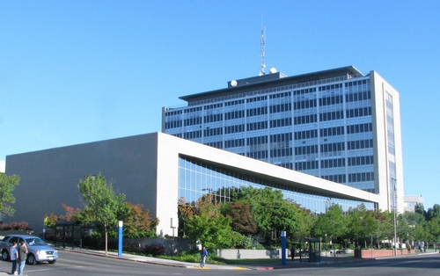
What is a Jury Administrator?
Court officer who supplies the potential jurors for the court.
For any civil or criminal case, send potential jurors to courtroom:
District/Municipal Court case – 15 (on average)
Superior Court case – 35 (on average)
Important to have enough people to serve on juries.

Slide 9
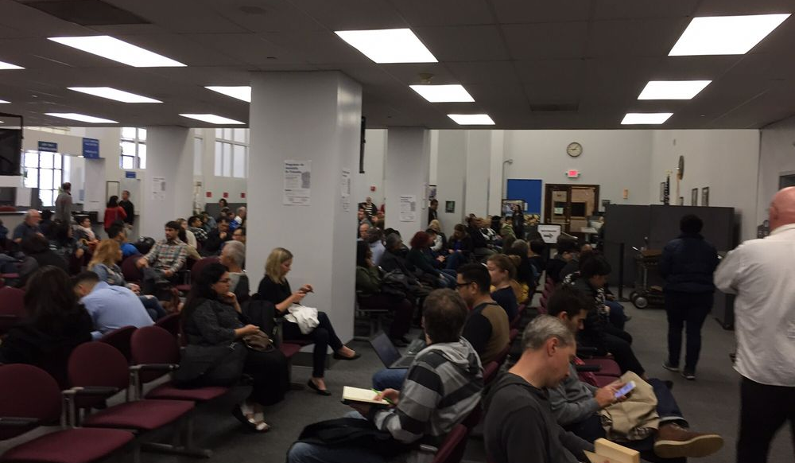
Roleplay – Jury Administrators and possible jurors
A. Count off one to six.
B. All sixes are Jury Administrators
C. All one - fives are possible jurors;
#1 is Juror 1
#2 is Juror 2, etc.
D. Read your handout and follow directions.
E. Jurors present their facts to the Jury Administrators.
F. Jury Administrators will decide what happens next – send to courtroom or let them go home.

Slide 10
Jury Administrators
A. Come to front of room
Jury Administrator 1A tells class
what your case was about
how long the trial is
what you decided about Juror 1.
B. Each Jury Administrator reports about their case, trial length, and decision on Juror 1.
C. Jury Administrators 1A,1B, 1C, 1D, 1E report on Juror 2, then Juror 3, etc.
D. Ask Jury Administrators how they felt in making decisions.

Slide 11
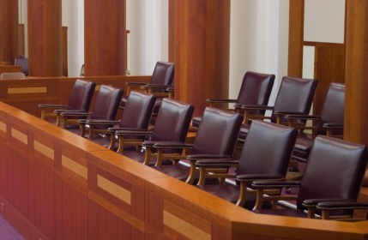
Voir Dire
Who will actually be on the jury?

