Slide 1
VAWA Reauthorization of 2013
THE TULALIP EXPERIENCE
Sharon Jones Hayden
Prosecuting Attorney
Tulalip Tribes
SAUSA Western District of Washington

Slide 2
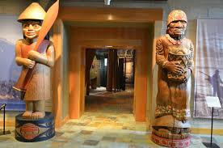
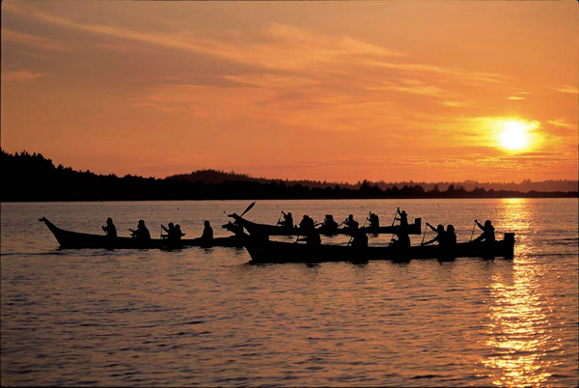
The Tulalip Tribes is…
A Sovereign Nation located in the NW corner of Washington state
A traditional fishing, hunting, and gathering tribe

Slide 3
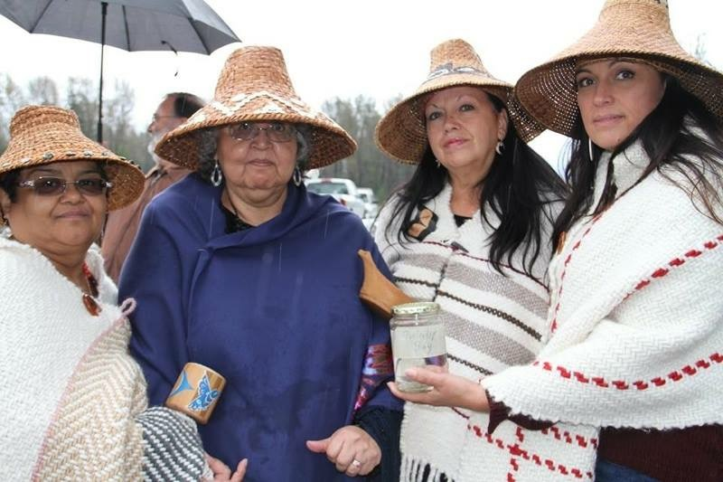
SOME FACES OF TULALIP

Slide 4
Terminology
Indian
Native
Native American
American Indian
Tribal Law v. Federal Indian Law
Preference: Use specific tribal identity whenever possible

Slide 5
BACKDROP OF TRIBAL CRIMINAL JURISDICTION
Inherent authority since time immemorial
United States limitations on inherent authority
Plenary power of Congress
Implied divestiture by the Supreme Court

Slide 6
TRIBAL CRIMINAL PROSECUTION – THE OUTER LIMITS
LIMITED to prosecution of members of federally-recognized tribes – Oliphant v. Suquamish 1978
LIMITED to 1 year incarceration, $5000 fine or both – Indian Civil Rights Act of 1968
LIMITED in terms of jail space / resources for probation
NO limitation on traditional tribal remedies for resolving violent crime and oppression.**

Slide 7
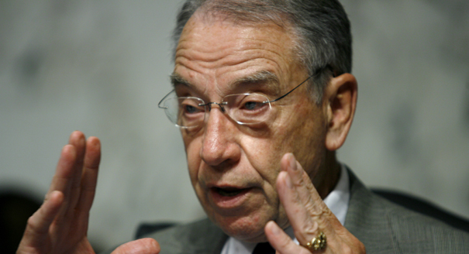
[O]n an Indian reservation, [a jury is] going to be made up of Indians, right? So the non-Indian doesn’t get a fair trial.
Grassley, 159 Cong. Rec. S582 (Feb. 11, 2013)

Slide 8
INDIGENOUS PERSPECTIVE
Concerns about relying on Anglo-American models to address gendered violence
Institutionalizing and endorsing the United States as the protector of Native women
Tribal overreliance on Anglo-American “law and order” model
Perpetuating colonialism and assimilation by encouraging tribal governments to replicate the state/federal systems

Slide 9
Current Statistics at Tulalip
Thirty-three cases with twenty defendants
Age range of defendants 21-49
Defendants have had over 200 contacts with Tulalip Police Department since 2008 prior to these cases
9 Caucasian, 4 African American, 5 Hispanic, 1 Middle-Eastern, and 1 non-enrolled Canadian Indian
In 18 of the incidents, children were present; 9 of whom were victims
Results:
17 cases convicted
2 acquitted
1 prosecuted by US Attorney’s Office and our tribal SAUSA
8 pre-trial
5 dismissed

Slide 10
t'igwicid - thank you
Sharon Jones Hayden
Prosecuting Attorney
Office of the Reservation Attorney
SAUSA - WDW
6330 31st Avenue NE
Tulalip, WA 98271
360-716-4811
sjoneshayden@tulaliptribes-nsn.gov

