Slide 1
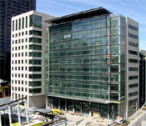
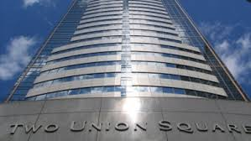
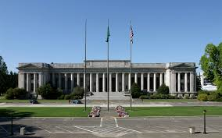
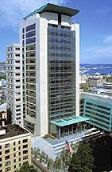
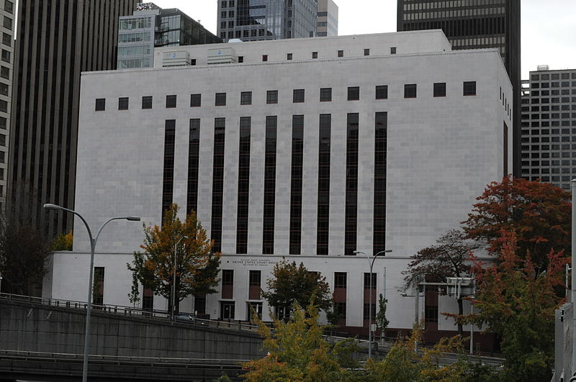
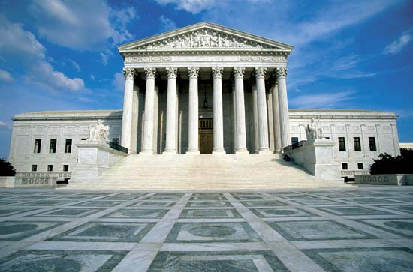
What do you know about courts?

Slide 2
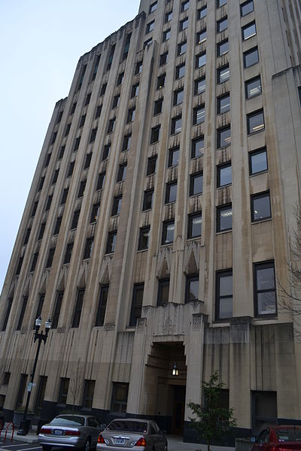
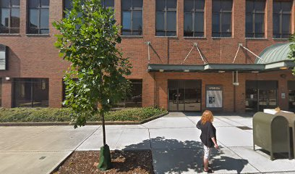
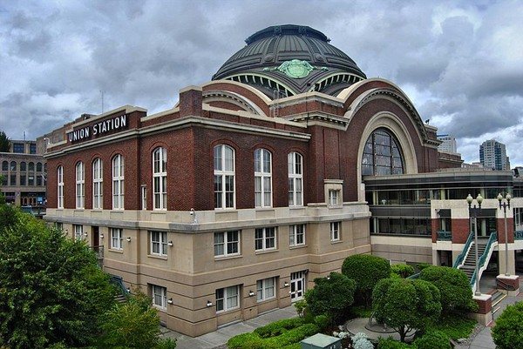
What do you know about courts?

Slide 3
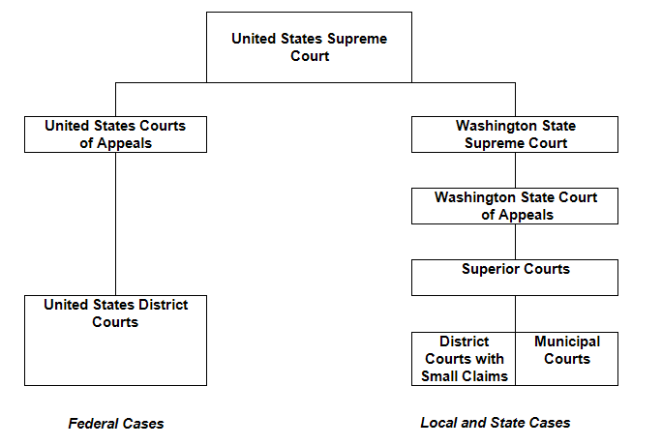
Claim Your Jurisdiction!

Slide 4
Federal Courts
What the case is about – U.S. Constitution, laws and treaties, admiralty and maritime law
Who the case involves – U.S. or one of its officers, ambassador or consul, one state suing another or a citizen of another state, citizens of a state or a state suing a foreign government or citizen, citizens suing citizens of other states when the case involves more than $75,000
Where the case occurs – military bases, federal property, Indian reservations

Slide 5
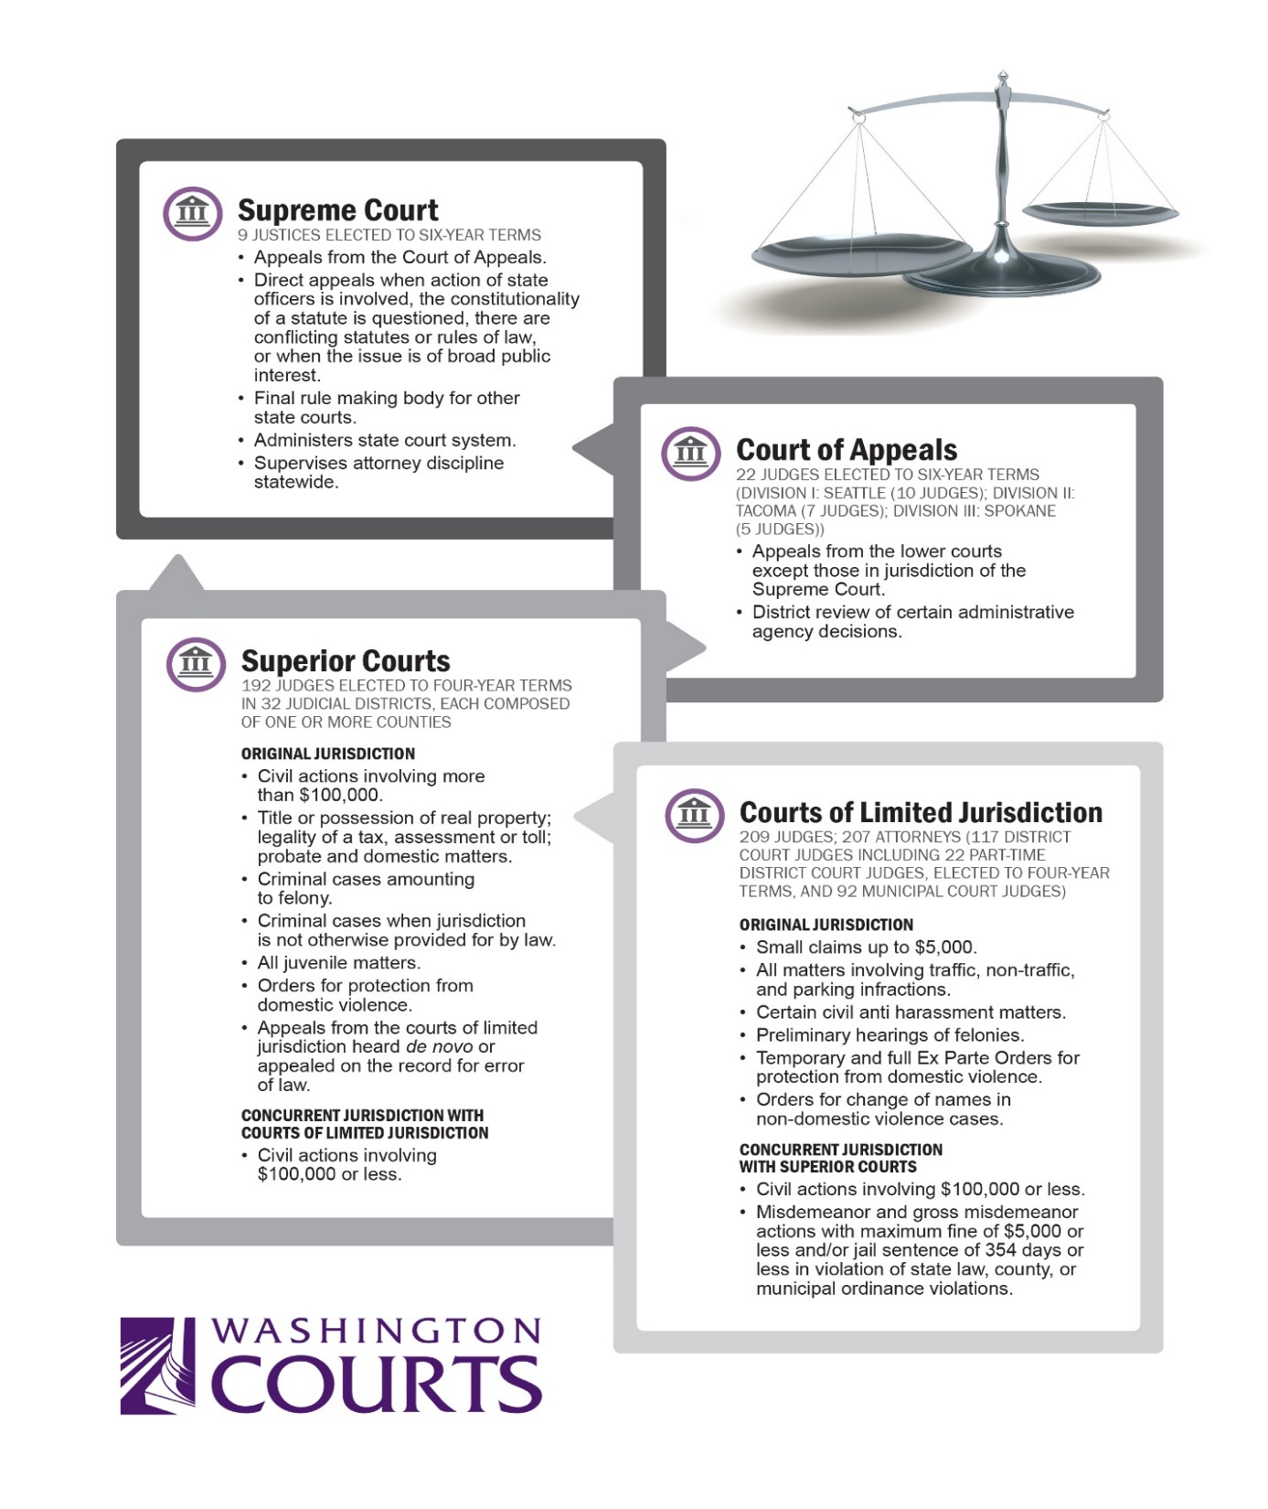

Slide 6
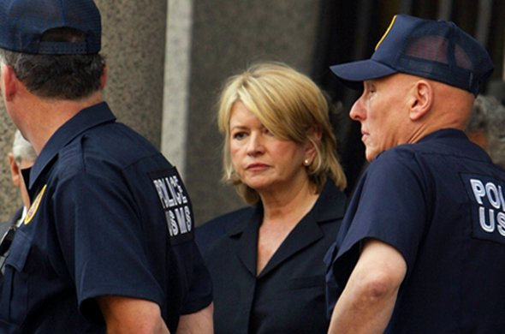
1. Martha shoots and kills her husband in Washington State. The state prosecutor brings charges in which court?

Slide 7
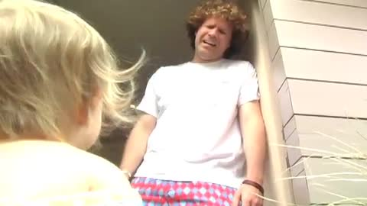
2. Larry's landlord refuses to return his damage deposit of $850 when Larry moves out of his apartment, even though the apartment is in excellent condition. Larry wants to sue his landlord, but doesn't want to hire a lawyer. In which court can Larry file suit?

Slide 8
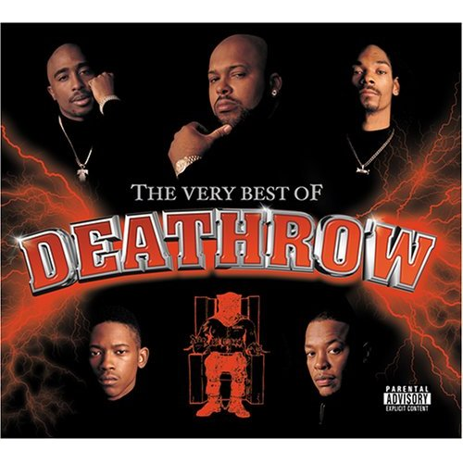
3. Frank has been convicted of murder in superior court and his sentence is the death penalty. He appeals his case to which court?

Slide 9
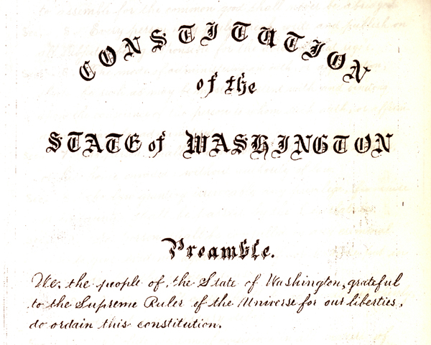
4. Some parents with their children sue the state for failing to make ample provision for the education of all children residing with its borders as required by the Washington State Constitution.

Slide 10
5. The Superior Court Judge ruled in favor of the parents along with their children that the state had failed in making ample provision for the education of all students, in violation of the Washington Constitution. Which court hears the State’s appeal?

Slide 11
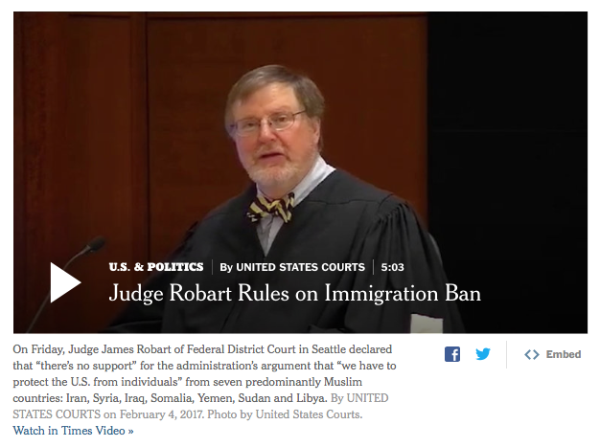
6. The State of Washington filed a lawsuit against President Donald Trump claiming that the President’s executive order to ban certain groups of individuals entering the United States violated the law and the Constitution. What court would hear this case?

Slide 12
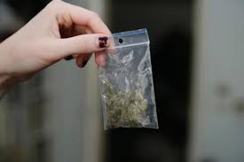
7. Sara, who is 25 years old, is arrested for a small amount of marijuana in her purse. Which court would her case be in?

Slide 13
8. A non-profit corporation opposed to United States support for Israel submitted an ad to run on the outside of county buses. After initially agreeing to accept the ad, the bus system rejected the ad saying it would likely result in vandalism and violence. In what court should the non-profit corporation file its case to claim a violation of free speech?

Slide 14
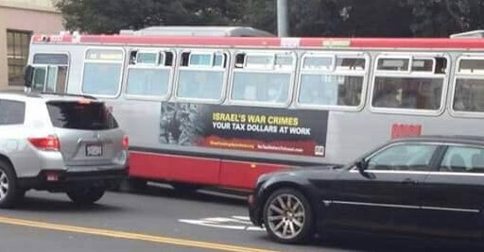
9. After the non-profit lost its case to run the ads on the buses, to what court should it appeal?

Slide 15
10. Martha appeals her conviction in Superior Court in Clallam County for murder in the second degree to which court?

Slide 16
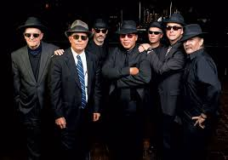
11. Alice Singer sues a famous band for stealing her song and violating her copyright in which court?

Slide 17
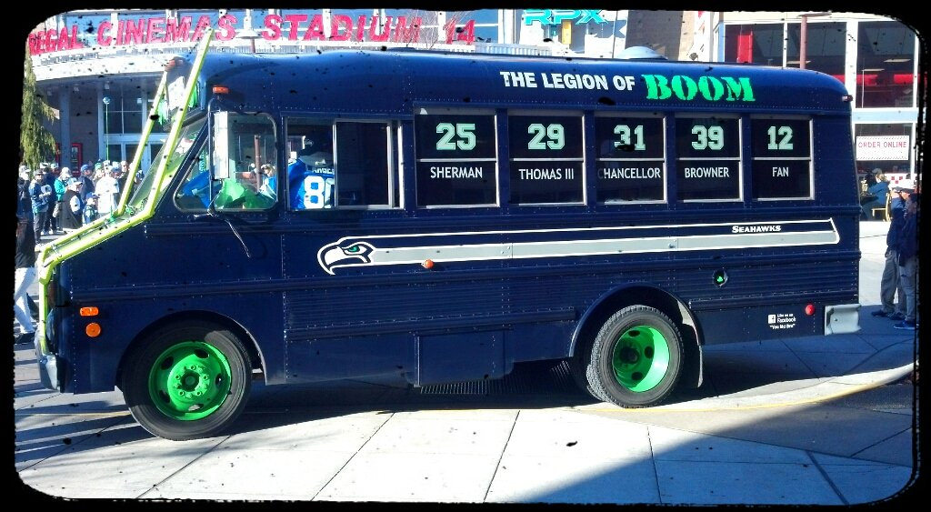
12. Kelly is cited for her disruptive behavior on a city bus. Which court will hear her case?

Slide 18
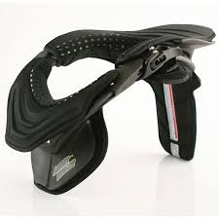
13. Yolanda was in a car accident in which she injured her neck. She sues the driver of the other car for $90,000 in which court?

Slide 19
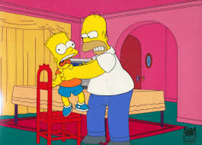
14. Regina is charged with a misdemeanor of fourth degree assault in which court?

Slide 20
15. Arnold was convicted of burglary in the first degree by a jury in Superior Court. He appeals his conviction to which court?

Slide 21
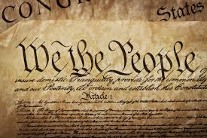
16. The United States District Court rules that the state initiative to terminate mandatory busing violates the equal protection clause of the United States Constitution. The state of Washington appeals to which court?

Slide 22
17. The United States Courts of Appeals upholds the United States District Court’s ruling that the state initiative to terminate mandatory busing is unconstitutional. The state asks which court to review the decision?

Slide 23
18. A Superior Court judge rules that the state law against cross burning is unconstitutional. The prosecutor appeals this decision to which court?

Slide 24
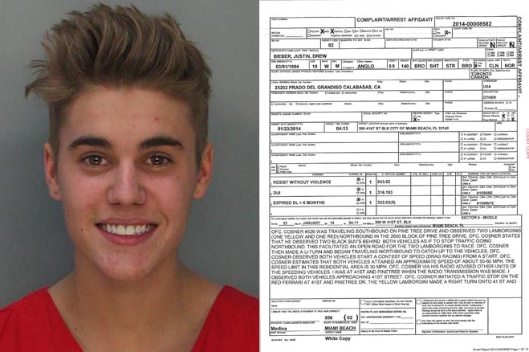
19. Jesse (aka Justin) is arrested for driving while intoxicated within the city limits of a large city. In which court is he charged?

Slide 25
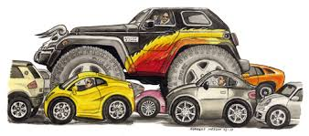
20. Elizabeth, who lives in Seattle, crashes her car into Juan’s sports utility vehicle, causing injuries and damages of $120,000. Juan, who is from Oregon, files a lawsuit in which court?

Slide 26
21. Disabled individuals appeal a jury verdict that said a movie theater did not violate their rights under the federal Americans with Disabilities Act. In which court is the appeal filed?

Slide 27
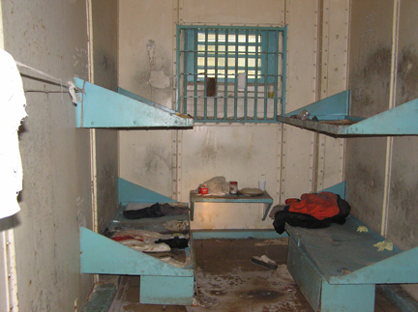
22. Inmates ask this court to review their case from the state’s Supreme Court, claiming that the jail failed to provide them with basic human needs.

Slide 28
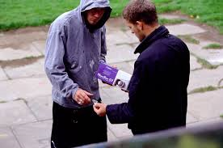
23. The state Court of Appeals overturns Austin’s conviction for selling drugs, based on an illegal search and seizure. The state asks which court to review the decision?

Slide 29
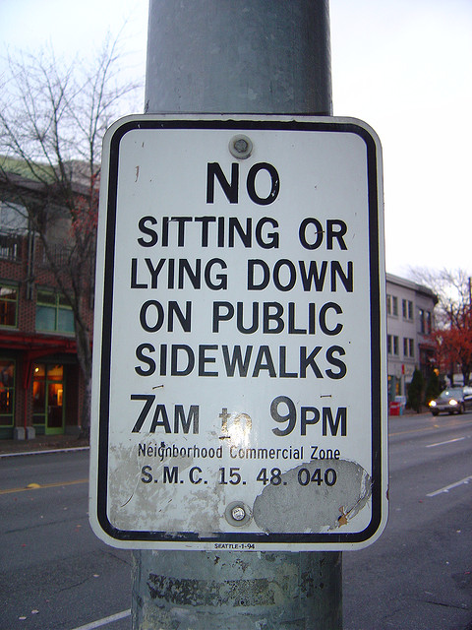
24. Maya is cited for sitting on the sidewalk in violation of a local ordinance. In which court will her case be tried?

Slide 30
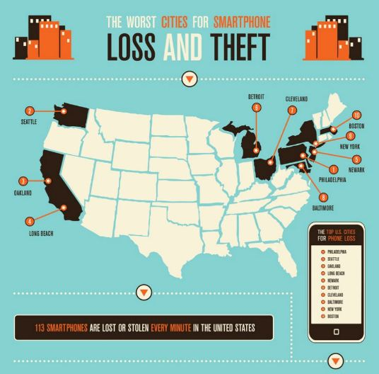
25. T’Andre, who is 14, is charged with theft of a smart phone in which court?

