Slide 1
Creating and effecting local criminal justice reform
The Honorable Mary Ann Moreno
Spokane County Superior Court
Gloria Ochoa-Bruck
Director of Multicultural Affairs
City of Spokane
Dr. Jacqueline van Wormer
Spokane Regional Criminal Justice Administrator
Washington State University
Notes:
2012 – Blueprint for Reform
Jail at critical status = 965

Slide 2
Historical background
RCW 72.09.300 requires that every county in the state shall establish a local law and justice council.
Spokane County originally established one in 1991, but it went dormant at some point before the year 2000.
In late 2013, a locally-formed Criminal Justice Council (jointly appointed by the BoCC and Spokane Mayor) adopted the Blueprint for Reform, an independent analysis of our system, which recommended 43 reforms, including re-establishment of the Spokane Regional County Law and Justice Council (SRLJC).
Critical to create a robust, active Council and Subcommittee process

Slide 3
Subcommittees
The SRLJC currently has nine subcommittees comprised of the SRLJC Board, other criminal justice system members, and community members.
  Administrative Committee
  Evidence based practices
  Facilities
  Performance measures
  Racial equity
  Risk/needs/responsivity
  Strategic planning
  Technology
  Bail reform
Notes:
It is from this work on the subcommittees, with active community involvement, and through the ”champion” role of select Judges, that we have come to focus on key areas of reform.
We have taken a data driven approach to our work, mapped our current system and built reforms based on consensus of leaders. This process has lead us to focusing on reducing our local jail population – which is a topic/area that has started to gather a great deal of national attention.

Slide 4
The Process
Data Driven
  Review of national level data/research
  Scrutiny of local data
Systems Mapping
Community Involvement
Racial/Equity toolkit questions
Notes:
In addition to the Blueprint for Reform, subcommittees worked to analyze the current operations of the system, and in partnership with a $150,000 Phase I MacArthur Grant, we engaged in these following steps.

Slide 5
The National Picture of Jails

Slide 6
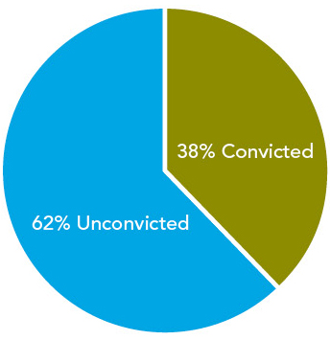
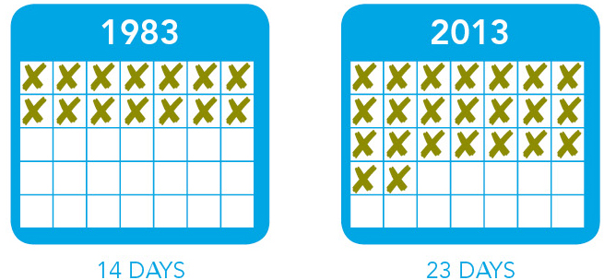
The Big Picture of Jails
Annual Admissions = 11,700,000
  This is 19 times the number of admissions to prison (631,000)
Jails hold both convicted and unconvicted inmates
  62% are unconvicted and presumed innocent
  38% are convicted and serving sentences generally less than 1 year
Average lengths of stay have been increasing over the past 30 years
Notes:
First Bullet: The number of individuals in jail is lower than admissions because so many individuals are admitted multiple times per year

Slide 7
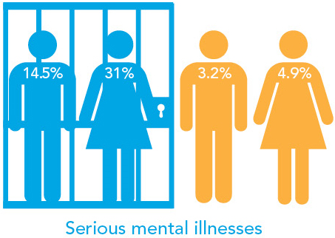
Mental Illness & Substance Use
Jails have become the provider of last resort for people with mental health issues
  Serious mental illness affects men and women in jail at rates four to six times higher than in the general population
  Sixty-eight percent have a history of abusing drugs, alcohol, or both

Slide 8
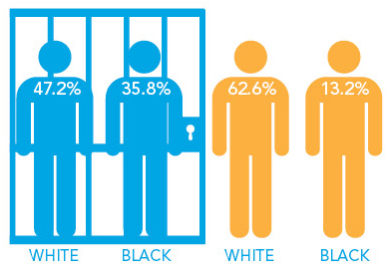
Racial & Ethnic Disparities
Jails often hold minorities at much higher rates than whites
  Nationwide African Americans are jailed at almost four times the rate of white Americans

Slide 9
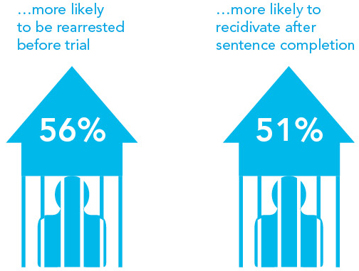
Consequences
Compared to low-risk defendants held for no more than 24 hours, those held for 8-14 days were…
Notes:
Outcomes are worse for defendants even when they are held for just 2 or 3 days.
Those who are detained in jail are also more likely to receive a sentence of imprisonment (4x) and receive a longer sentence (3x).

Slide 10
Spokane County Data Review:
Who is in our jail?

Slide 11
Legal Status
Notes:
All jurisdictions should work towards creation of these standardized reports. Templates and suggestions for process can be provided.

Slide 12
Jail vs. County Population by Race
Jail Population, 2014
County Population, 2014

Slide 13
Charges

Slide 14
Notes:
ATMP TO ELUDE PURSU POLICE VEH
VIOL OF ORDER(PRIOR CONVIC)
VIOL OF ORDER(ASSLT/RECK)
SEX/KIDNAP OFFENDER(FAIL TO REG)FEL
ESCAPE FROM COMMUNITY CUSTODY
UNLAWF POSS FIREARM-2D(PREV CONV)
MALICIOUS MISCHIEF-2ND DEG
UNLAWFUL POSS PAYM INSTRUM(COMBINATION)
BAIL JUMPING(CLASS B FELON)
VEH(DUI-FELONY)
FORGERY(MAKE/COMPLETE/ALTER)
VOYEURISM
INDECENT EXPOSURE (PRIOR CONV)

Slide 15
Length of stay

Slide 16
Overall, all populations
Notes:
20,152 released in 2014.

Slide 17
By Race
Notes:
Average for all races is 17 days.

Slide 18
bail

Slide 19
Bail Amounts (Snapshot, 6/30/15)

Slide 20
Page 2

Slide 21
Strategies Under SJC
RNR System
Robust Pretrial Services
Diversion
Case Processing
Goal: 21% reduction in ADP of jail population by 2019

Slide 22
Goal: Reduce Jail Admissions/ LOS / RED
Arrest
LE Deflection
Assignment of Counsel
RNR Application
Pretrial Release
RNR Application
Charge
MH Diversion Facility
Prosecution Diversion
RNR Application
RNR Application
Expansion of PTS
Case Processing
RNR Application
Portability Pilot
Social Worker Hire
Bail/Release Grid Development
Disposition/Sentencing
RNR Application
No-Fee Diversion
Supervision
RNR Application
Restructure of Supervision
Training on CCP
Robo-Calling
MCAT Expansion
Portable Community Resource Room
MH Coordinator
Court Reminders
Appointment Reminders
RE Toolkit
RE Toolkit
RE Toolkit
RE Toolkit
RE Toolkit
RE Toolkit
RE Toolkit

Slide 23
Questions?
Jacqueline van Wormer, Ph.D.
jvanwormer@spokanecounty.org
(509) 628-2663
Notes:
Judge Moreno & Gloria – I can insert your contact information, just please provide.

