Slide 1
Washington in the era of “Mass Incarceration”
David Boerner
Professor of Law Emeritus
Seattle University School of Law
Stacy Smith
Program Manager
Washington State Minority and Justice Commission

Slide 2
18, 445 Inmates in 2015

Slide 3
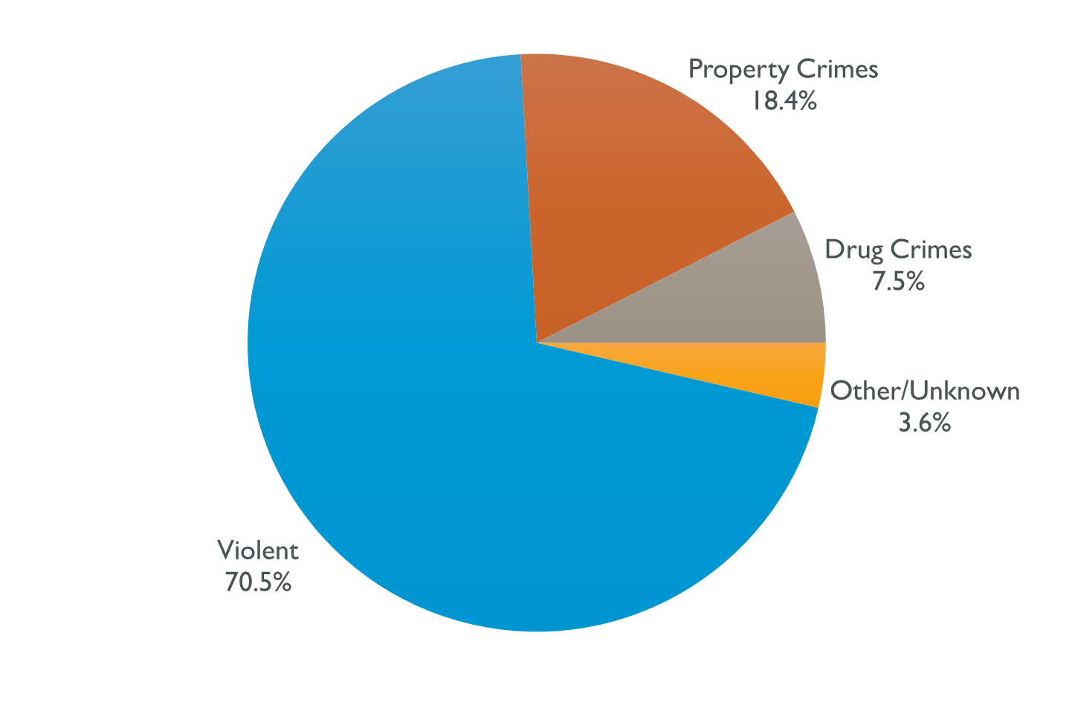
2015: all inmates by Crime

Slide 4
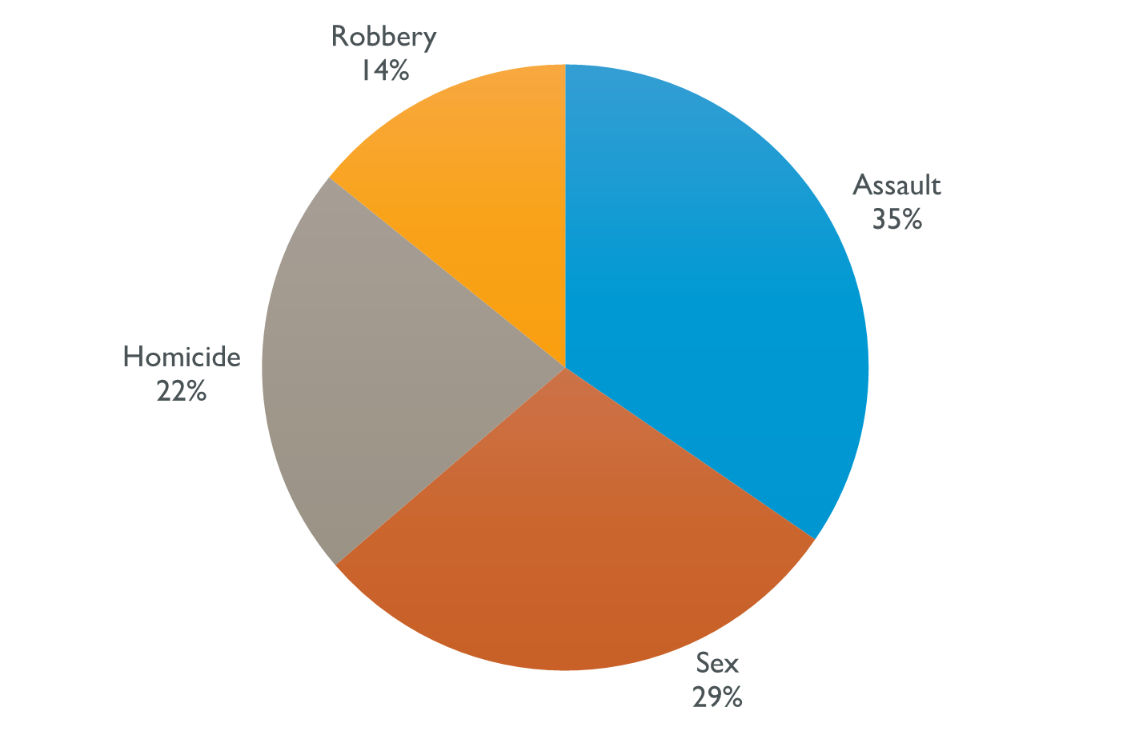
2015: Violent crimes by type

Slide 5
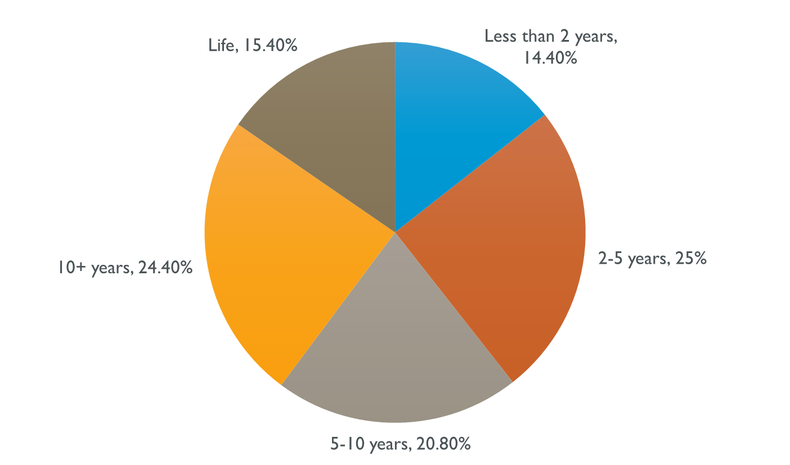
How long are sentences

Slide 6
2014 Race/ethnicity
Race/Ethnicity | % of Total Inmates | % of Total Population
White | 71.6% | 81.2%
Black | 18.0% | 3.9%
AIAN | 4.6% | 1.8%
Asian/Pacific Islander | 3.7% | 8.4%
Hispanic | 12.8% | 12.2%
Other | 1.1%
Unknown | 1.0%

Slide 7
Legislative policy
1981:
“Emphasize confinement for the violent offender and alternatives to total confinement for the non-violent offenders.”
RCW 9.94A.040(5)

Slide 8
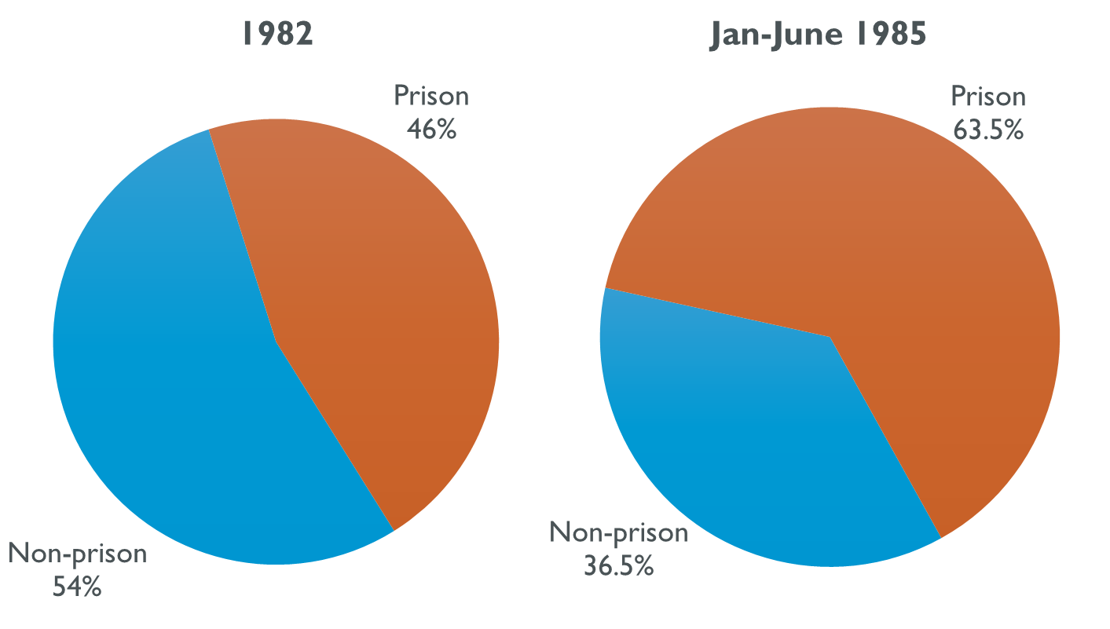
Violent Offenses

Slide 9
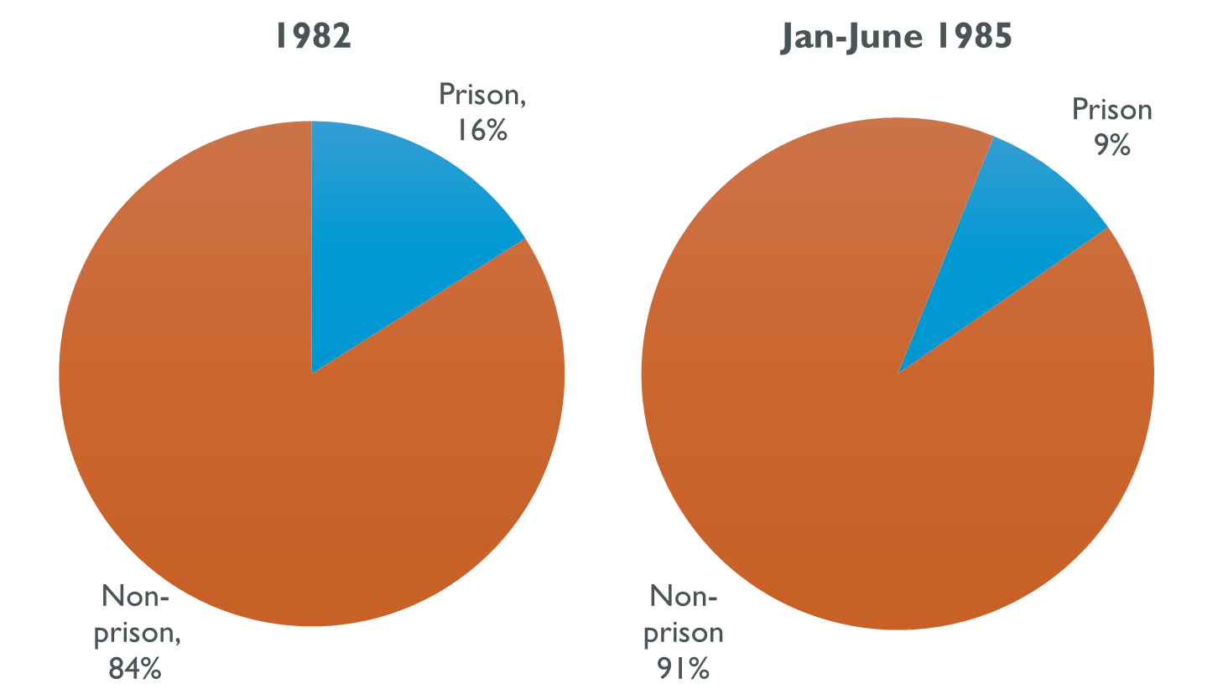
Nonviolent offenses

Slide 10
Legislative policy changes: “War on drugs” comes to Washington
1987:
First time offender waiver (FTOW) abolished
1989:
Increase sentence length
Multiple scoring of prior offenses
School zone enhancement

Slide 11
Prison Population by Crime type 1990-2015

Slide 12
Revised public policy
1991:
Community Protection Task Force – increased sentence length for sex offenses
1993:
“3 Strikes” Initiative 593
1995:
“Hard Time for Armed Crime” Initiative 159

Slide 13
Legislative Policy
2003:
Drug grid adopted
Sentence length decreased
Multiple scoring of prior offenses eliminated

Slide 14
Violent crimes 1990-2015

Slide 15
Contact Professor Boerner with questions about this material at (253)709-1181.

