Slide 1
FY2025 CLJ Therapeutic Court A19 and Reimbursement Process
TJ Grace, Court Program Specialist, Behavioral Health Program

Slide 2
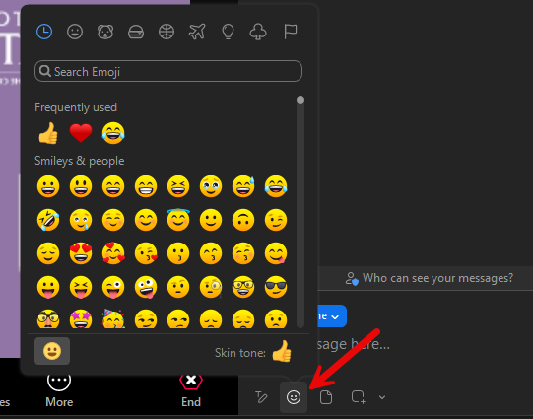
Intros and Ice Breaker
Verbally or via chat
State your name
Tell us what court/program/agency you work for
What is an emoji that represents how you’re feeling today?

Slide 3
What We’ll be Covering
A19 Form
Required information
Correct formatting
Backup Documentation
Required documents by spending category
Marking up documents
Reimbursement Request Submission
A19 Packet
Monthly or quarterly submission options
30 day turnaround

Slide 4
FY2025 CLJ Therapeutic Court A19 and Reimbursement Process
A19 Form

Slide 5
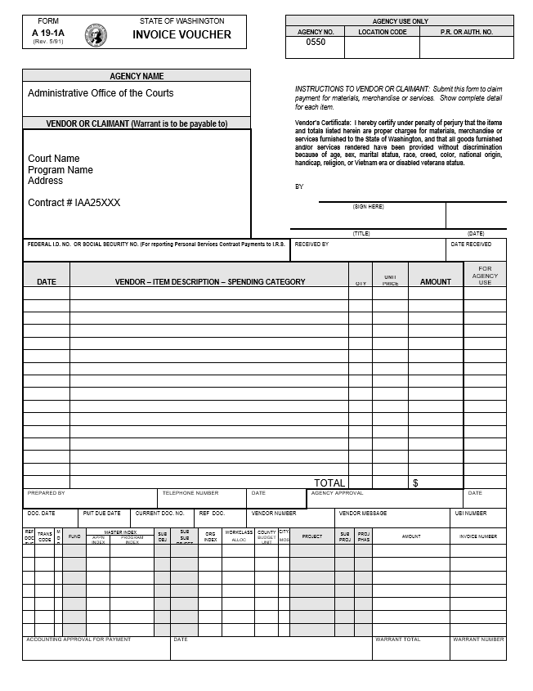
A19 Form
State form A19-1A
Itemized voucher used for reimbursement for monies spent on your therapeutic court program
Authorizes AOC Procurement & Contracts to generate a payment to your court
Notes:
See the bold lines around the fields that are required by you to complete? Do not use the fields below the bold line under the Prepared By field. Those are reserved for the AOC when processing your payment.

Slide 6
A19 Form
Vendor/Claimant Section
REQUIRED INFO:
Court Name,
Court Address,
Contract Number
Optional: Program Name (e.g. DUI/DWI Court, Mental Health/Behavioral Health, Veteran’s Court, etc.)
REQUIRED INFO:
Signature,
Title, Date Signed
Court Federal Tax ID #
/s/ Sandy Cheeks
Court Coordinator 8/15/24
12-3456789
Notes:
These are commonly missed items on A19 forms. I will send one email to your court requesting you resubmit and include the required information by a certain deadline. If I don’t hear back or you miss the deadline, you won’t get reimbursed for that quarter. If the person who submits is out of town, or out of office, I need to know who to contact in their place. It’s important we remain in contact during the reporting submission period.
Signatures: DO NOT use Adobe signature to validate an e-signature. This prevents us from being able to edit your A19 packet if needed. Payables needs specific information on your A19 form to process payment to your court. If you have a signature certificate on your PDF, Payables can’t process your submission. Contact me for more information and I can help you set up an e-signature in Adobe that doesn’t require validation.

Slide 7
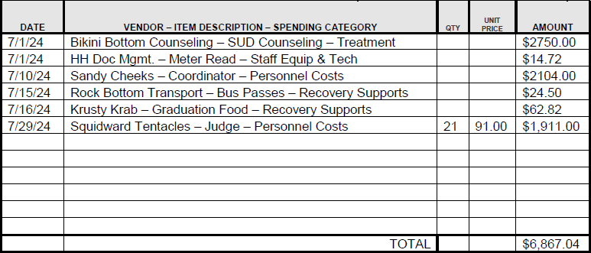
A19 Form
Line Item Section
REQUIRED INFO
Date
Date of transaction or invoice date
List these in order chronologically (earliest date to latest date)
Vendor – Item Description – Spending Category
e.g. Bikini Bottom Counseling – SUD Counseling – Treatment Services
e.g. HH Document Management – Meter Read – Staff Equipment & Technology
Notes:
Each invoice/receipt/charge to this funding is its own line item on the A19 form. Make sure your dates are accurate. When parsing through your backup documents, it helps us understand which line item is for which invoice. Attach your backup documentation chronologically. This will dramatically increase the speed of processing for me and Payables.
Make sure to use this formatting for the description field. It’s important that this data is accurate. Need to ensure we’re both charging line items to the same spending category so my accounting matches up with yours at the end of the year. We use this data when we’re considering funding for your court, for the AOC and the legislature to understand how these funds are being used, and for research purposes.

Slide 8
A19 Form
Line Item Section cont.
REQUIRED INFO
Amount
Total amount charged to this funding source for the line item
Optional
Qty
Applies if showing hours spent on court
e.g., Squidward spent 21 hours acting a Judge for the month of July
Unit Price
e.g., Judge Squidward charges $91.00/hr.
$91/hr. x 21hrs = $1,911.00
Notes:
The quantity and unit price fields are optional as shown in the orange boxes. They can help show your math to help us reconcile your reimbursement. Use discretion when completing these fields, if it doesn’t make sense to use for every line item, don’t.
Make sure your line item amounts reflect the exact amount for that invoice being charged to this funding. Use callouts on your backup documentation to justify the amount charged if different than the invoice total.

Slide 9
A19 Form
REQUIRED INFO
Total
Total up the amounts from all line items and include in Total row
Preparer Info
Name, Phone Number, Date prepared
Notes:
Use the A19 form included in the invite for this training. It’s updated with a total row for your convenience. This is a required field on your submission. If you are missing a total, I will send one email to your court asking you to correct your submission by a certain date. If I don’t hear back or you miss the deadline, you won’t get reimbursed.
The phone number is a requirement for Payables to reach out if they need assistance from you to process payment to your court. I won’t return your submission if you didn’t complete the name and date prepared fields.

Slide 10
Required Info Recap
Submissions missing this information will be returned to the sender citing insufficient requirements.
It’s important that you’re checking your submissions for accuracy and completeness before submitting.

Slide 11
A19 Form
Tips for Success
Required info is included and listed in appropriate place
One line item per purchase
One A19 form per submission
You can choose to submit monthly OR quarterly depending on how your court functions
Include all expenses incurred for the reporting period onto one from
Add rows to your A19 form to add more line items
See instructional video

Slide 12
FY2025 CLJ Therapeutic Court A19 and Reimbursement Process
Backup Documentation

Slide 13
Backup Documentation
Reimbursement requests document
what you purchased,
that you paid for what you purchased,
and if appropriate, that you received what you purchased
For each cost that you request reimbursement for, backup documentation is required
Remember that you can only request reimbursement for purchases that are either approved as part of the contract or approved in a written exception request
Refer to IAA Attachment B: Use of Funds for allowable and non-allowable expenses

Slide 14
Backup Documentation
What’s required by Spending Category
Personnel Costs
Paystubs, payroll reports, or accounting reports
Must have pay period start and end dates
Staff Equipment & Technology, Treatment Services, Recovery Supports
Invoices and/or receipts
Must have vendor name,
Date of service or invoice date, and
Description of services rendered/purchased
Don’t include every page of invoice unless has callouts for specific charges

Slide 15
Backup Documentation
What’s required by Spending Category
Team Training & Travel
Conference Registration Fees & Memberships
Original receipt with vendor name, name of registrant(s), date of purchase
Lodging
Reimbursed at established per diem rate, exceptions require pre-approval
Original receipt with traveler name, dates of stay, total amount charged to payment method
Transportation & Parking over $50
Original receipts
Keep tips under 15%
No reimbursement for travel to/from places of entertainment
No reimbursement for travel to dinners outside of meal periods

Slide 16
Backup Documentation
What’s required by Spending Category
Team Training & Travel continued
Court travel advance or travel reimbursement forms
Name of traveler, date approved/reimbursed
Don’t include mileage documentation. Charged at established mileage rate
Meals while in Travel Status
Don’t include receipts for meals. Charged at established per diem rate
Meals with Meetings
Use AOC policy or your court’s policy
Must include sign-up sheet or list of attendees

Slide 17
Backup Documentation
Tips for Success
Call out amount charged to funding using marker or pen
If marking up paper copy before scanning, use permanent marker, not a highlighter which doesn’t translate in a scan
Use Adobe Acrobat features to add comments, highlight, etc.
Ensure minimal, accurate and legible documentation
Only include required backup documents, remove blank pages, excess pages
If receipt is hard to read, mark it up so we can interpret it
Ensure the invoice dates are within the reporting period

Slide 18
Backup Documentation
Tips for Success
Compile backup documents and A19 form into one PDF
Insert in order by date, same order as A19 line items
Convert Word, Excel, other formats to PDF
If you don’t have Adobe Pro, combine multiple files online
See instructional video
Notes:
Following this slide is a video on one way to compile your documents into one PDF. You can also open a pdf document and

Slide 19
FY2025 CLJ Therapeutic Court A19 and Reimbursement Process
Reimbursement Request Submission

Slide 20
A19 Packet
Combined file in PDF format containing the A19 form and all required documentation
Submitted for processing to CLJTherapeuticCourtsApplications@courts.wa.gov AND Payables@courts.wa.gov
If you don’t follow this submission process, you won’t get reimbursed
The better organized and clear your A19 packet is, the faster it gets processed = faster reimbursement to your court
Notes:
I will do a reconciliation of all expenses at the end of every quarter. If I didn’t receive an A19 reimbursement request from your court, I will send one email asking you to submit by a certain date. If I don’t hear back or if you miss the deadline, you won’t get reimbursed for that quarter. If you’re having trouble getting your invoices in by the submission deadline, I need to know that and will accommodate accordingly.
See the bold lines around the fields that are required by you to complete? Do not use the fields below the bold line under the Prepared By field. Those are reserved for the AOC when processing your payment.

Slide 21
Payment & Billing Procedures
IAA Sections IV & V
The Court shall submit invoices to AOC for expenditures no more frequently than monthly, and no less frequently than quarterly.
Stick to one submission option so as not to duplicate purchases by mistake
Keep claims limited to the reporting period
If submitting on a monthly basis, limit invoices to the month reporting
e.g., a monthly A19 submitted on Aug. 15th should only contain invoices for services rendered in July

Slide 22
Payment & Billing Procedures
IAA Sections IV & V
Before payment can be processed, properly-completed A-19 invoices must be submitted to payables@courts.wa.gov with CC to CLJTherapeuticCourtsApplications@courts.wa.gov
Maintain sufficient backup documentation of expenses under this agreement
If we reach out for additional information, there is an expectation that you will have that information ready and available

Slide 23
Reimbursement Process
Expect payment from AOC within 30 days of receipt of properly completed A19 packet
Check with your finance team to ensure correct method of payment
e.g., direct deposit, check, warrant
Check first with your finance team before reaching out about missing payments
Contact TJ and Payables@courts.wa.gov for any issues re: payments, payment methods, etc.

Slide 24
Reporting Schedule
FY25 Period | Quarter | A19 Submission and Report Due
07/01/24 - 09/30/24 | Q1 | 10/15/24
10/01/24 - 12/31/24 | Q2 | 01/15/25
01/01/25 - 03/31/25 | Q3 | 04/15/25
04/01/25 - 06/30/25 | Q4 | 7/15/25 (final report for the year)
Notes:
Don’t wait until the deadline to submit. If you have your documentation and A19 form ready to submit, feel free to send early. If you’re having trouble obtaining the required backup documentation, let me know and I can help by granting a later submission date, meeting with your vendor(s), etc. It’s important that you communicate any challenges you’re facing regarding these reporting requirements as soon as possible so we can assist in a timely manner.

Slide 25
Reimbursement Request Checklist
Court name, address, contract number listed
Signed with title and date
Listed preparer phone number
Line items are in order by date (earliest to latest)
Accurate total listed
Backup documents attached to A19 in one PDF and attached in order of line items listed on A19
A19 packet attached in email request sent to Payables@courts.wa.gov AND CLJTherapeuticCourtsApplications@courts.wa.gov

